Slide 1

Internship In Skill-Lync
Ecommerce Clothing Website
BY : KAILASH RAJKUMAR

Slide 2
INTRODUCTION
• OVERVIEW:
The ‘E-commerce Website’ Services department strives to provide solutions to develop and
transfer easy and efficient way in the digital age and to help reduces the human pressure and
time. To help support shop collections, the digital initiatives, and external partner institution
digital projects, It provide services that include the digitization of analog objects,
metadata management, digital preservation, and discovery and access of digital
collections. “Shop Management System” is a web application written for all operating
systems, designed to help users maintain and organize shop virtually. This software is easy
to use for both beginners and advanced users. It features a familiar and well thought-
out, an attractive user interface, combined with strong searching Insertion and
reporting capabilities. The report generation facility of shop system helps to get a good
idea of which are the various items brought by the members, makes users possible to get
the product easily. The ‘Ecommerce Web application’ Services department strives to provide
solutions to develop and transfer easy and efficient way in the digital age and to help reduces
the human pressure and time.
• PURPOSE:
The project is about to handle all the information of the shop regarding members. Also it
manages resources which were managed and handled by manpower previously. The main
purpose of the project is to integrate distinct sections of the shop into consistent
manner so that complex functions can be handled smoothly. The project aims at the
following matters Automation of product manipulation.

Slide 3
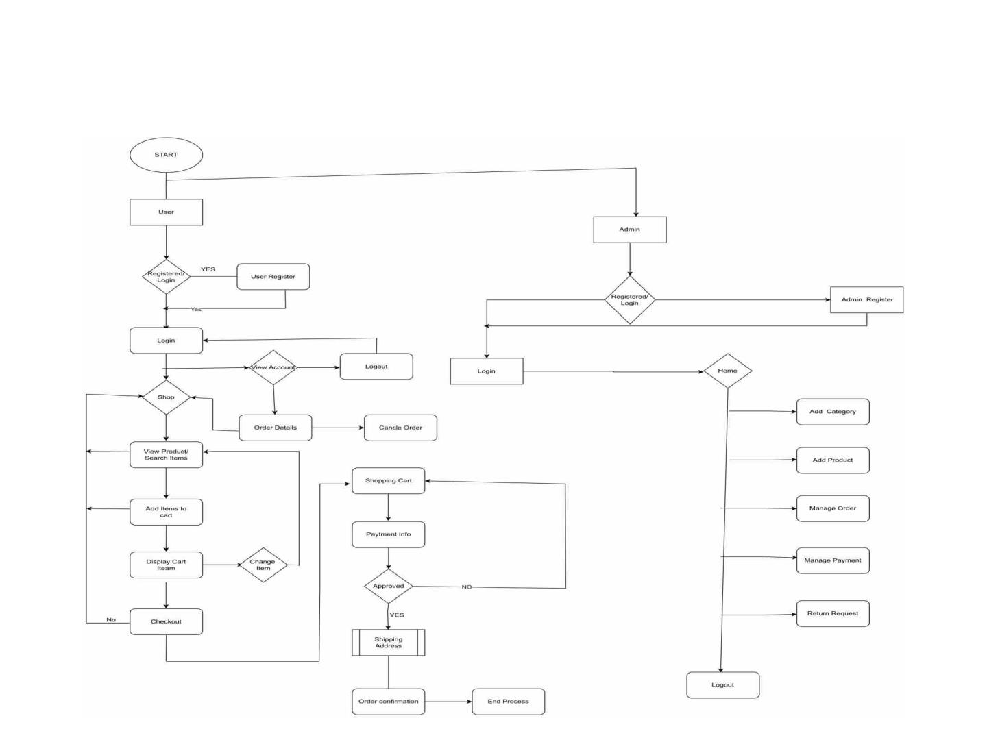
FLOWCHART

Slide 4
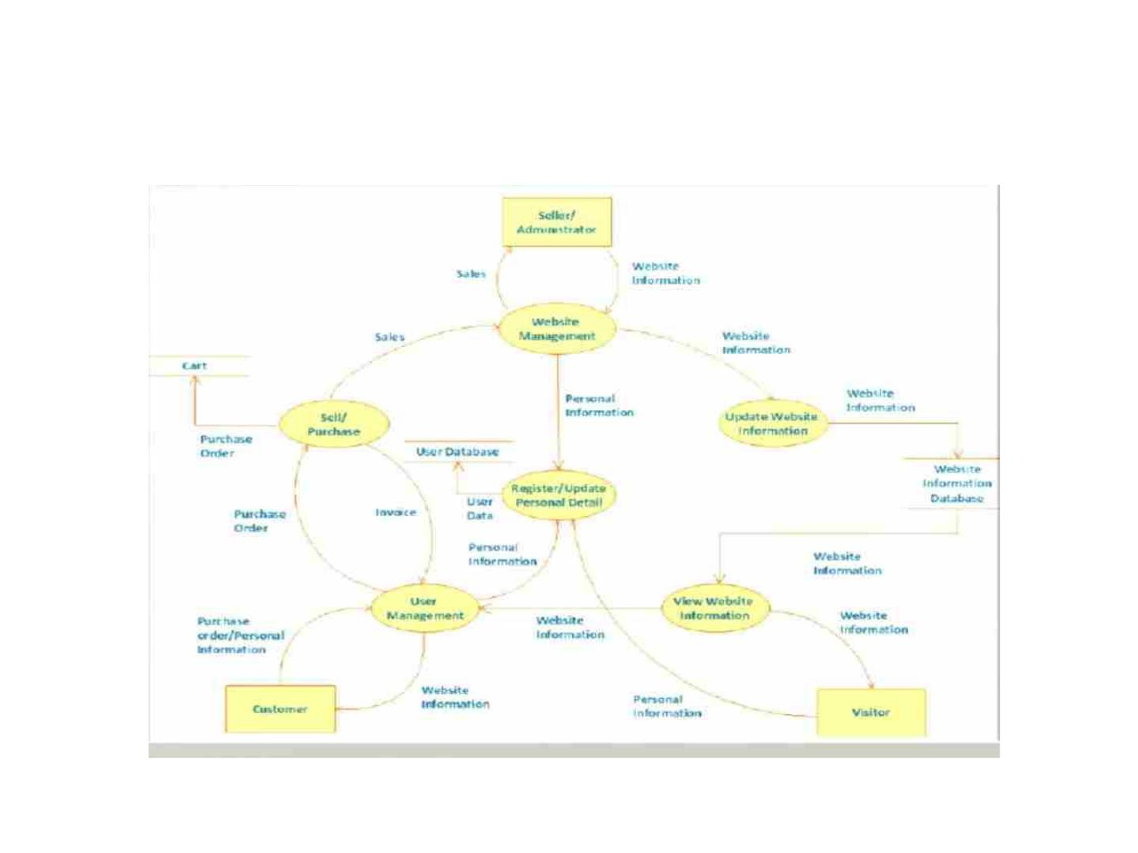
CONTEXT DIAGRAM

Slide 5
SYSTEM-DESIGN
The system is divided into some parts these are Sign-Up Page, Login Page, Seller Page, Home
Page, Product Page, Add Product Page, Men's Accessories, Cart Wish List Page, Cart page,
Order Received Page. Viewing System side with database represent the server using FireBase
Console For User, Seller, Products Database and AWS Console S3 Bucket For Added Products
From Seller Showing In Home Page.
USER CHARACTERISTICS
1. ADMIN:
The administrator has all the rights to access the system. He is the one who has all rights to
view the members and product details, modify those details. He can add various product
based on the category. He can also set the available quantity of a product and its reasonable
price. Also he can also set discount in various occasion. Admin can also view the details of a
member. The admin have the power to generate the scratch card so that users can also use
the recharge card to buy various product

Slide 6
2. USERS & SELLER:
The USERS & SELLER can log in to the system by using his specific email and password. Users
can view the products and order the products according to their own needs and Seller can
add the products and update the products easily. User can find various product by selecting
the in home page easily and add the products to Cart or Wishlist . And go to the Cart Page to
confirm the order.
System Information
This system is an automated Shop Management System. Through the software user can add
members, add product’s, buy the product’s, while order is placed the user get an email with
the ‘Order Received Dialogue Box in the Email’ in quick time. The system has the following
advantages:
1. User friendly interface
2. Fast access to database
3. Look and Feel Environment

Slide 7
HARDWARE AND SOFTWARE REQUIREMENT
Hardware Required:
1. Processor : Intel i3 or Above
2. RAM : 2GB or above
3. Hard Disk : 50GB or above
4. Input Devices : Keyboard, Mouse
5. Output Devices : Monitor
Software Required:
1. Operating System : Linux, Mac, Windows 7 or Above
2. Frontend : HTML,CSS, Bootstrap, JavaScript
3. Backend : Firebase Console, AWS Console S3 Bucket
4. Local host : Node Js – NPM Local Host

Slide 8
IMPLEMENT TOOLS FOR PROJECT
TOOLS
• HTML
• CSS
• JAVASCRIPT
• FIREBASE CONSOLE
• AWS CONSOLE S3 BUCKET
• NODEJS – NPM LOCALHOST

Slide 9
HTML [HYPERTEXT MARKUP LANGUAGE]
•
•
•
HTML (Hypertext Markup Language) is a markup language used to create web pages and
other types of documents that can be displayed in a web browser. HTML consists of a series
of tags that are used to define the structure and content of a web page.
HTML is used to create the basic structure of a web page, including headings, paragraphs,
lists, and links. It is also used to add images, videos, and other media to a web page, and to
create forms that allow users to interact with the web page.
In addition to its use in creating web pages, HTML is also used in email newsletters, online
forums, and other types of digital communication. Because it is a standardized language,
HTML allows web developers and designers to create web pages that are compatible with a
wide range of devices and web browsers.

Slide 10
CSS [CASCADING STYLE SHEETS]
•
•
CSS (Cascading Style Sheets) is a stylesheet language used to describe the presentation and
style of a web page written in HTML. CSS is used to define how HTML elements should be
displayed, including their layout, color, typography, and other visual aspects.
CSS allows web developers and designers to separate the presentation of a web page from its
structure and content, making it easier to update and maintain the design of a website. CSS is
also used to create responsive web designs that adapt to different screen sizes and devices.
Some common uses of CSS include:
•
Layout: CSS is used to define the layout of a web page, including the positioning and sizing of
elements such as headers, footers, and navigation menus.
•
•
Typography: CSS is used to define the font family, size, color, and style of text on a web page.
Colors: CSS is used to define the colors used on a web page, including the background color,
text color, and colors used for links and buttons.
•
•
Effects: CSS is used to add visual effects to web pages, such as transitions, animations, and
hover effects.
Overall, CSS plays a crucial role in the design and presentation of modern web pages, making
it an essential tool for web developers and designers.

Slide 11
JAVASCRIPT
•
JavaScript is a programming language used to create interactive and dynamic web pages.
JavaScript is executed by a web browser, allowing web developers to create web applications
that can respond to user input, update the content of a web page dynamically, and interact
with web APIs.
Some common uses of JavaScript include
•
•
•
•
•
Client-side scripting: JavaScript is used to add interactivity to web pages, such as form
validation, animations, and pop-up alerts.
Web application development: JavaScript is used to create complex web applications that can
interact with web APIs, store data in databases, and perform other advanced functionality.
Dynamic web page updates: JavaScript is used to update the content of a web page without
requiring a full page reload, allowing for a more seamless user experience.
Browser extensions: JavaScript is used to create browser extensions that add functionality to
web browsers, such as ad blockers, password managers, and productivity tools.
Overall, JavaScript is a versatile programming language that plays a crucial role in modern
web development, allowing web developers to create rich and interactive web applications
that run seamlessly in web browsers.

Slide 12
FIREBASE CONSOLE
•
Firebase Console is a web-based user interface provided by Google that allows developers to
manage their Firebase projects. Firebase is a mobile and web application development
platform that offers a range of services to help developers build and scale their apps quickly
and easily.
•
•
Firebase can be used in JavaScript to provide functionality for web applications, and Firebase
Console can be used to manage and configure the Firebase services used in the application.
Here are a few examples of how Firebase Console can be used in JavaScript:
Authentication: Firebase Console can be used to configure authentication methods for a web
application, such as email and password authentication or social sign-in. Developers can use
the Firebase Authentication SDK for JavaScript to integrate these authentication methods
into their web application.
•
•
•
Real-time database: Firebase Console can be used to manage the real-time database for a
web application, including creating and managing data, setting security rules, and configuring
listeners to respond to changes in the data. Developers can use the Firebase Realtime
Database SDK for JavaScript to interact with the database in their web application.
Cloud storage: Firebase Console can be used to manage cloud storage for a web application,
including creating and managing buckets, setting access controls, and uploading and
downloading files. Developers can use the Firebase Storage SDK for JavaScript to interact
with the storage in their web application.
Overall, Firebase Console is an essential tool for managing Firebase projects used in
JavaScript, providing a centralized location for configuring services and managing data for
mobile and web applications.

Slide 13
AWS CONSOLE S3-BUCKET
•
•
Amazon Web Services (AWS) Console is a web-based user interface provided by Amazon that
allows developers to manage their AWS services. One of the popular services provided by
AWS is Amazon S3 (Simple Storage Service), which is a scalable object storage service that
allows developers to store and retrieve data from anywhere on the web.
AWS Console S3 Bucket is a feature of AWS Console that allows developers to create and
manage S3 buckets, which are containers for storing objects such as images, videos, and
documents. S3 buckets can be used to host static websites, store backup and archive data,
and provide secure file sharing for applications.
•
•
•
•
•
In JavaScript, developers can use the AWS SDK for JavaScript to interact with S3 buckets in
their web applications. Here are a few examples of how AWS Console S3 Bucket can be used
in JavaScript:
Uploading and downloading files: Developers can use the AWS SDK for JavaScript to upload
and download files to and from S3 buckets. This can be useful for storing user-generated
content, such as images or videos.
Hosting a static website: S3 buckets can be used to host a static website, and developers can
use the AWS SDK for JavaScript to interact with the website, such as listing objects in a bucket
or deleting objects.
Setting permissions: Developers can use the AWS SDK for JavaScript to set permissions on
objects in a bucket, such as making objects public or granting access to specific users or
groups.
Overall, AWS Console S3 Bucket is a powerful tool for managing S3 buckets used in JavaScript,
providing a centralized location for managing data and configuring permissions for web
applications.

Slide 14
NODE JS AND NPM
•
Node.js is an open-source server-side JavaScript runtime environment built on Chrome's V8
JavaScript engine. It allows developers to use JavaScript on the server-side, enabling them to
build fast and scalable web applications. Node.js is used for various purposes, such as
building web applications, command-line tools, and backend services.
•
•
NPM (Node Package Manager) is a package manager for Node.js, used to install and manage
packages or libraries that can be used in Node.js projects. It is the largest package registry in
the world, with thousands of packages available to developers.
Localhost is a network address that refers to the current computer, which is typically used to
refer to the computer on which the software is currently running. When a web application is
running on a developer's computer, it can be accessed through the localhost address, which
typically resolves to the IP address 127.0.0.1.
•
•
When developing a Node.js application, developers can use the npm package manager to
install packages and libraries from the NPM registry. They can then use the Node.js runtime
environment to run their application on their local computer, which can be accessed through
the localhost address in a web browser. This allows developers to test and debug their
applications locally before deploying them to a production environment.
Overall, Node.js and NPM are powerful tools for building fast and scalable web applications,
while localhost is a convenient way to access the application during the development process.

Slide 15
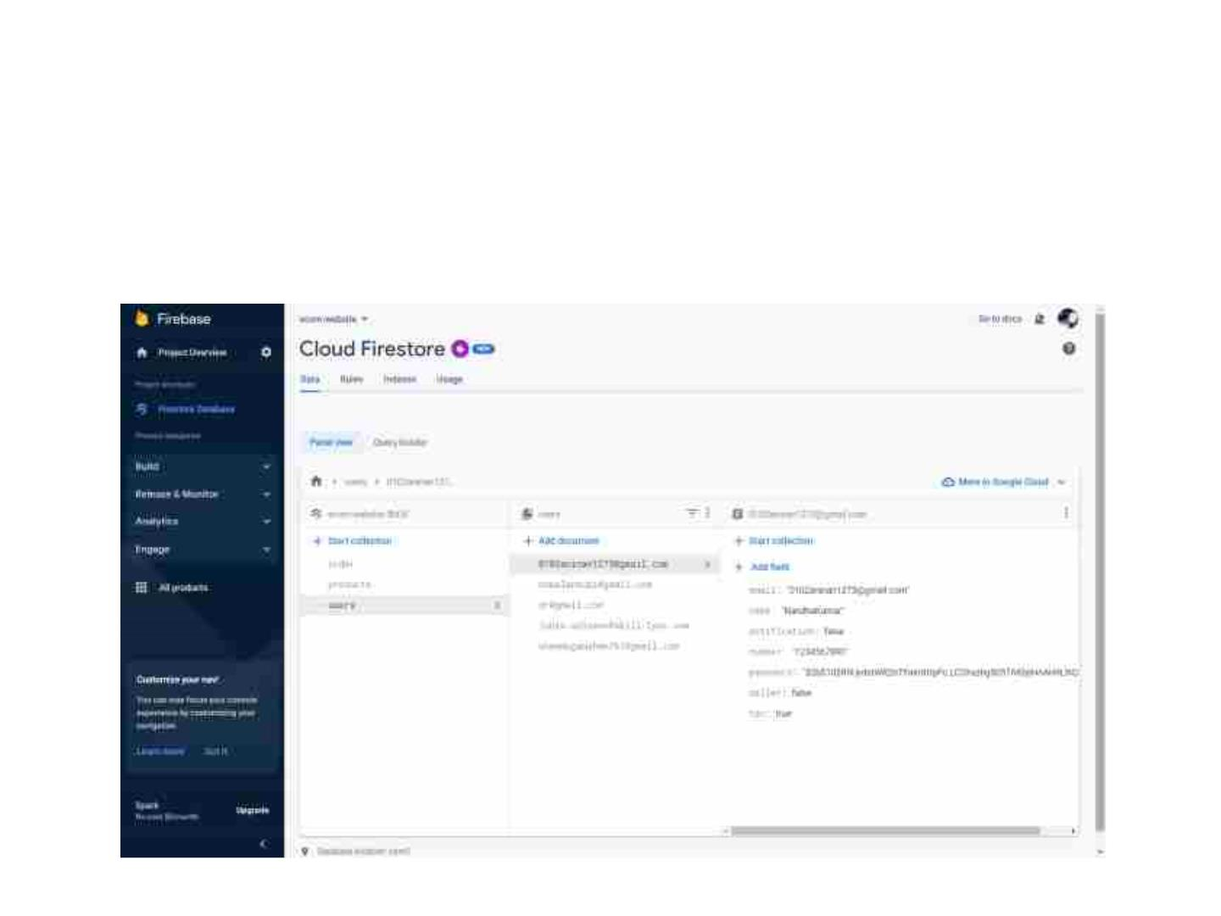
FIREBASE DATABASE
USERS DATABASE

Slide 16
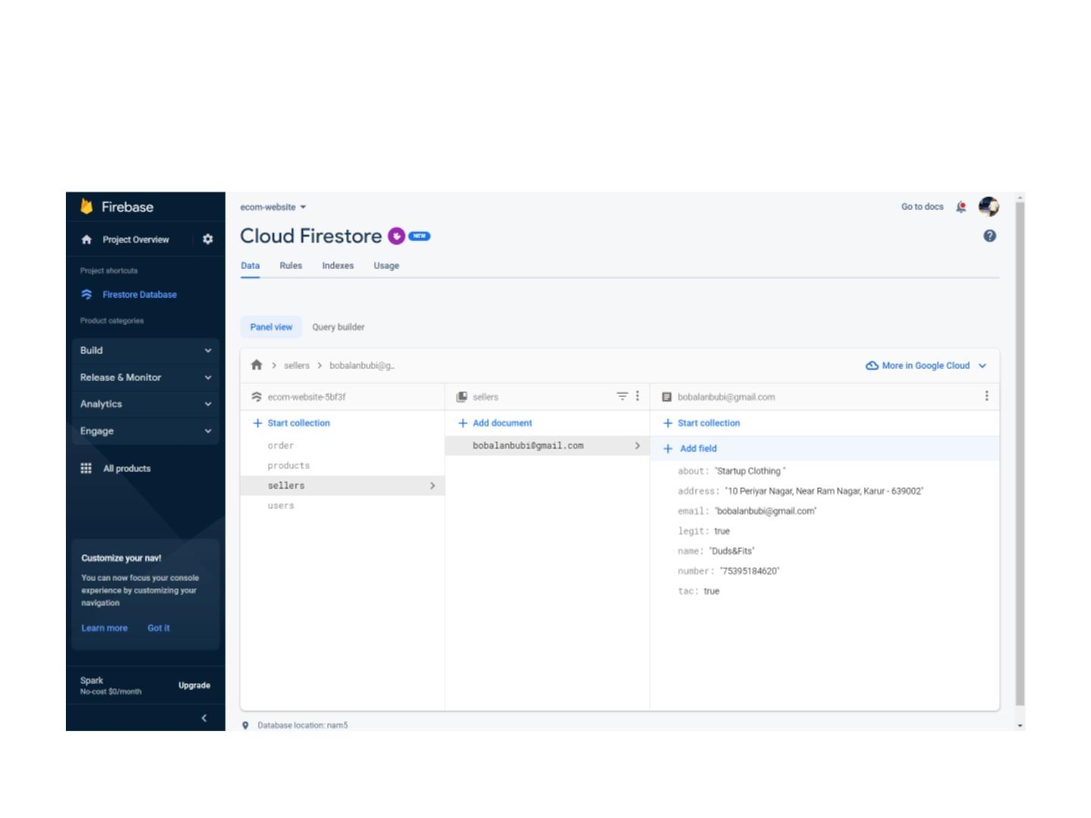
SELLER DATABASE

Slide 17
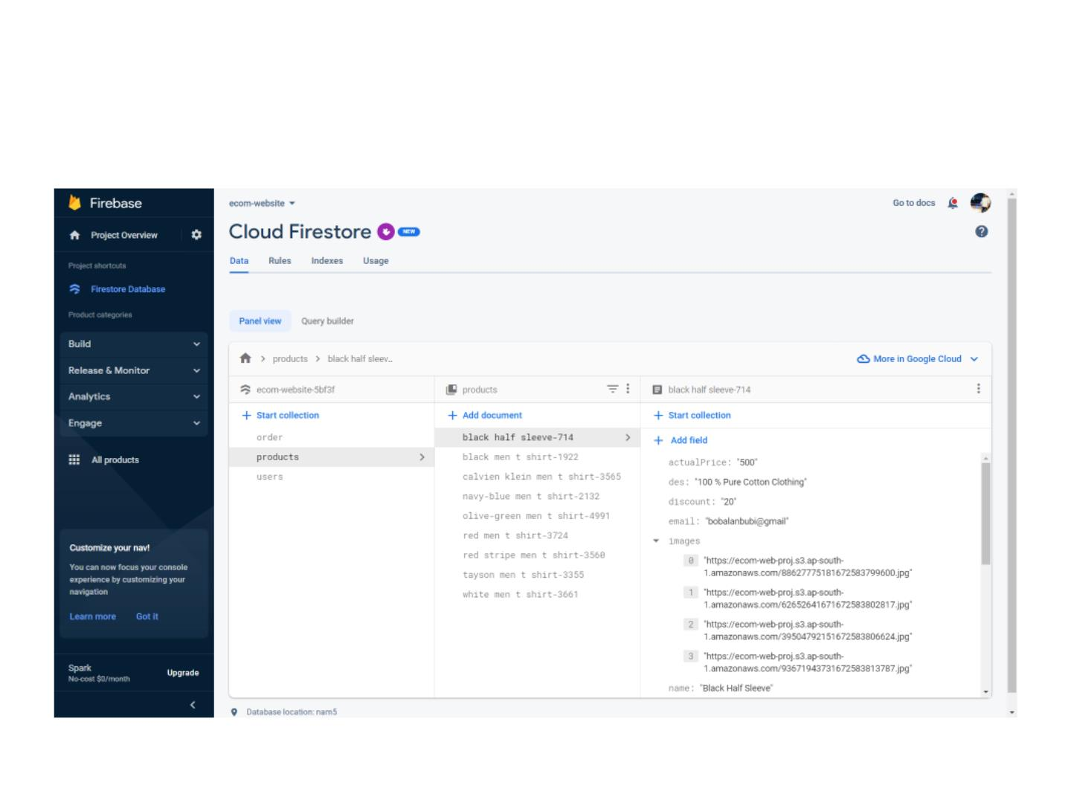
PRODUCTS DATABASE

Slide 18
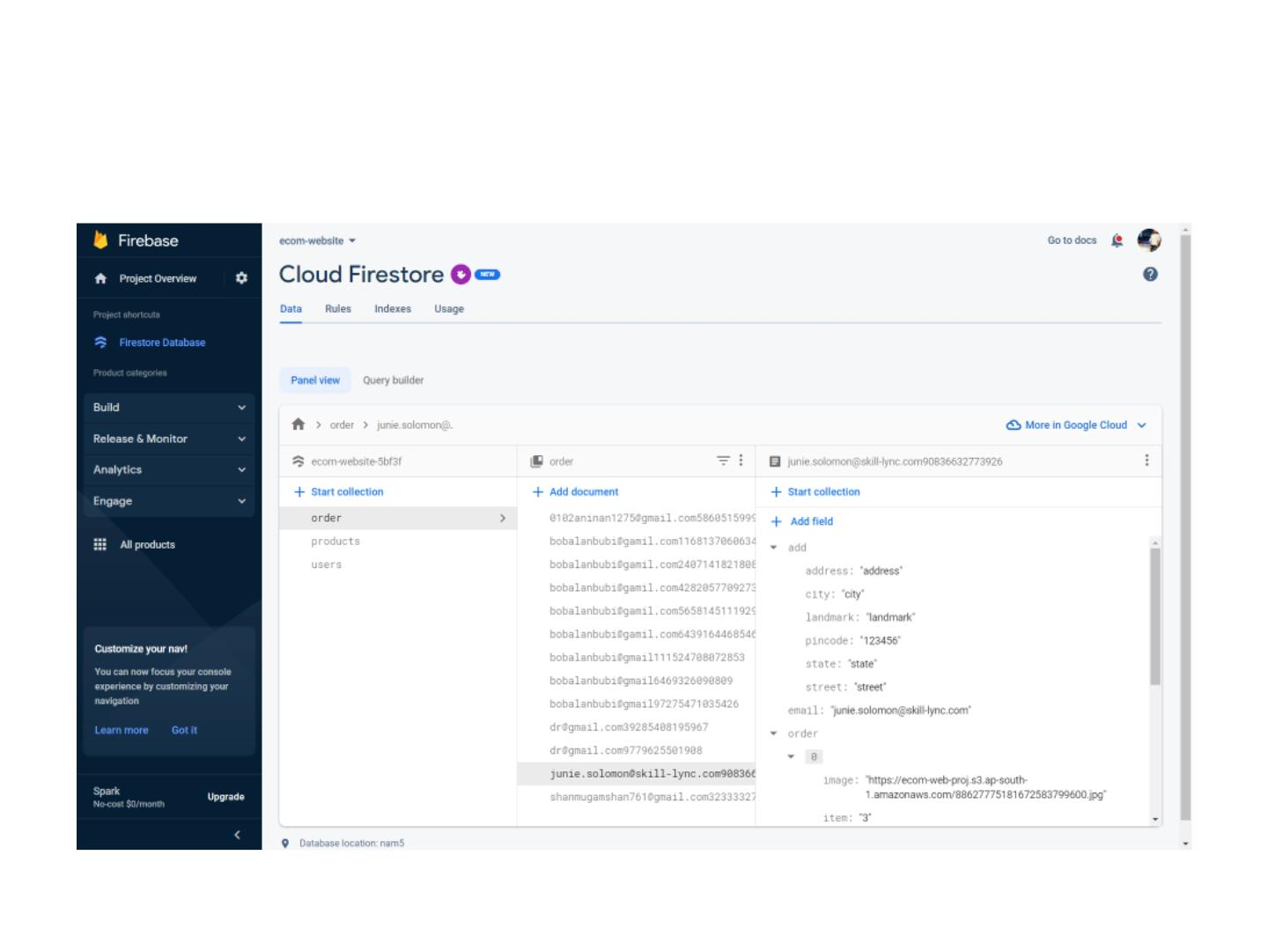
ORDER DATABASE

Slide 19
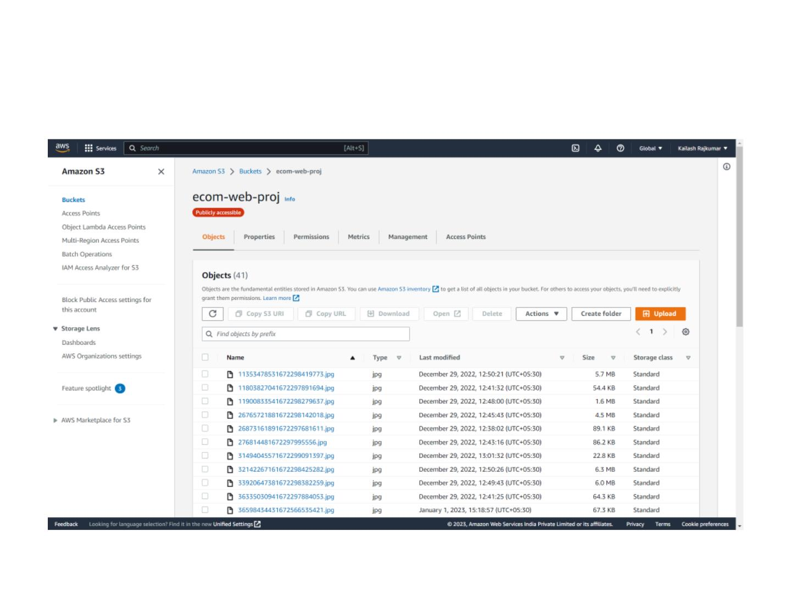
AWS DATABASE – S3 BUCKET

Slide 20
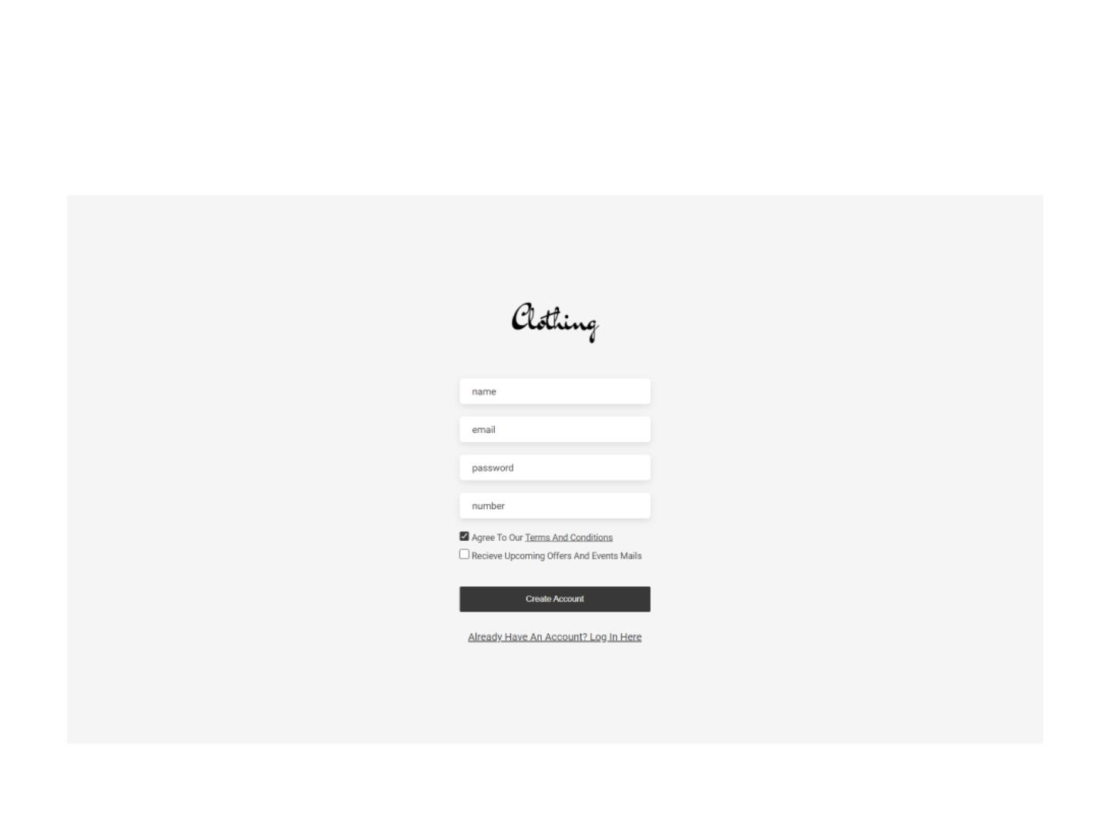
SIGN UP PAGE

Slide 21
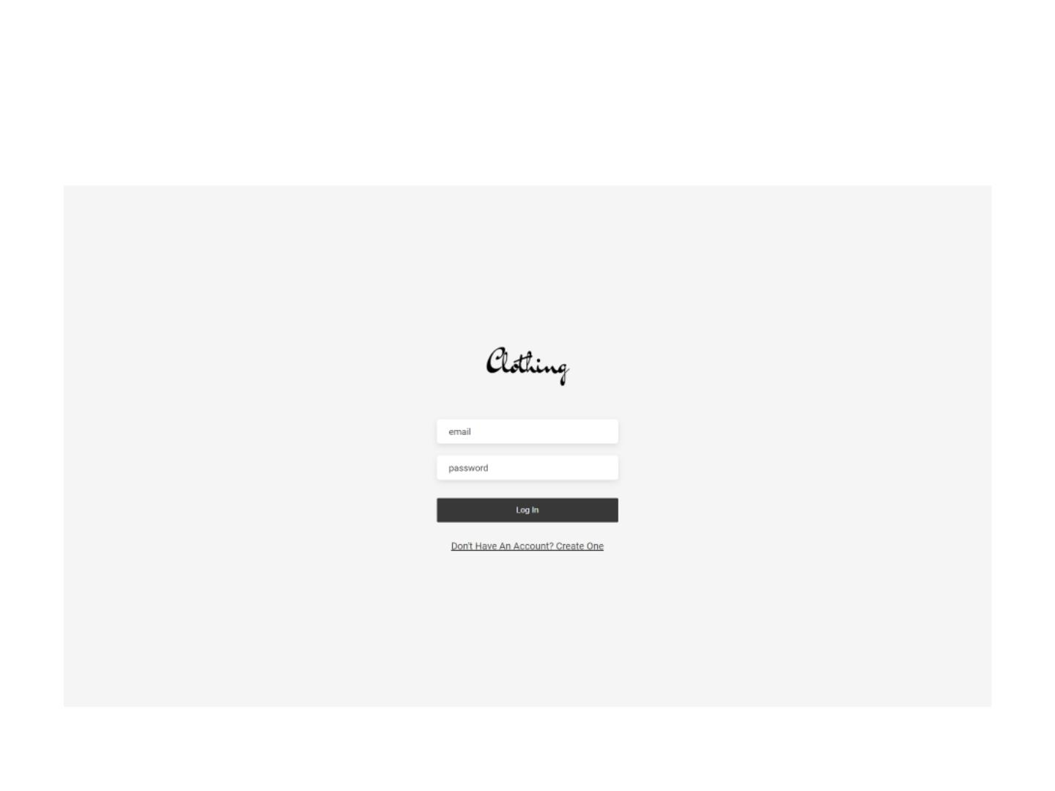
LOGIN PAGE

Slide 22
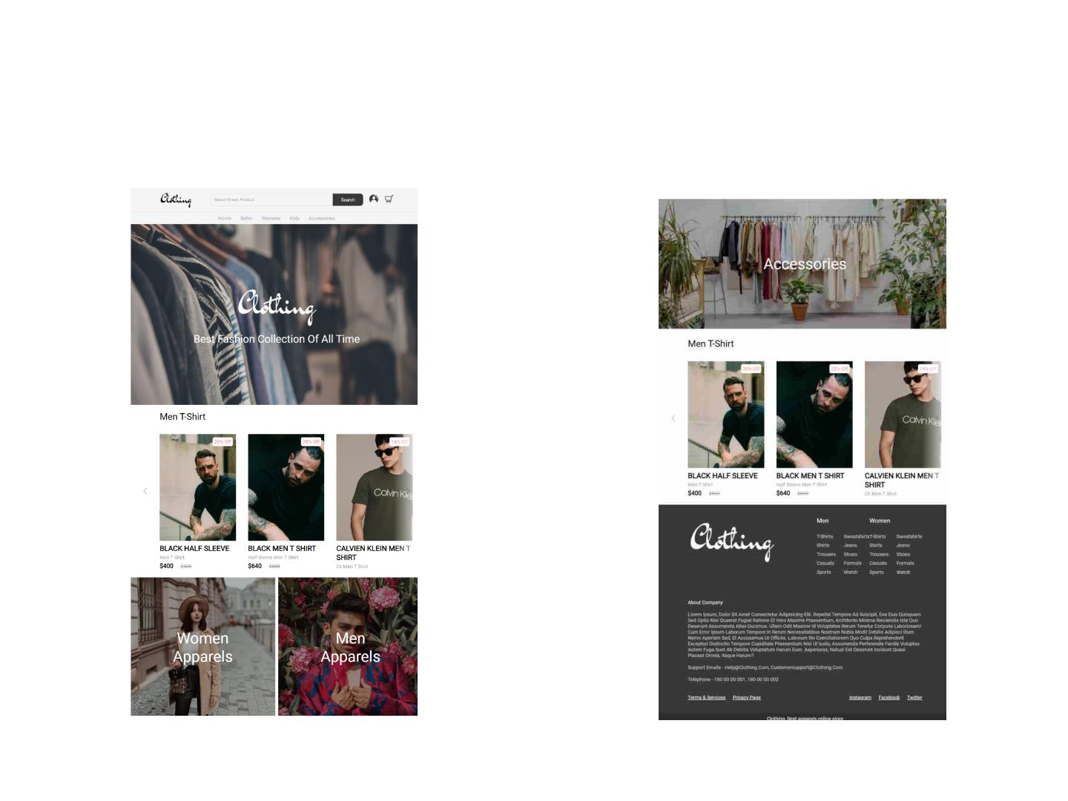
HOME PAGE

Slide 23
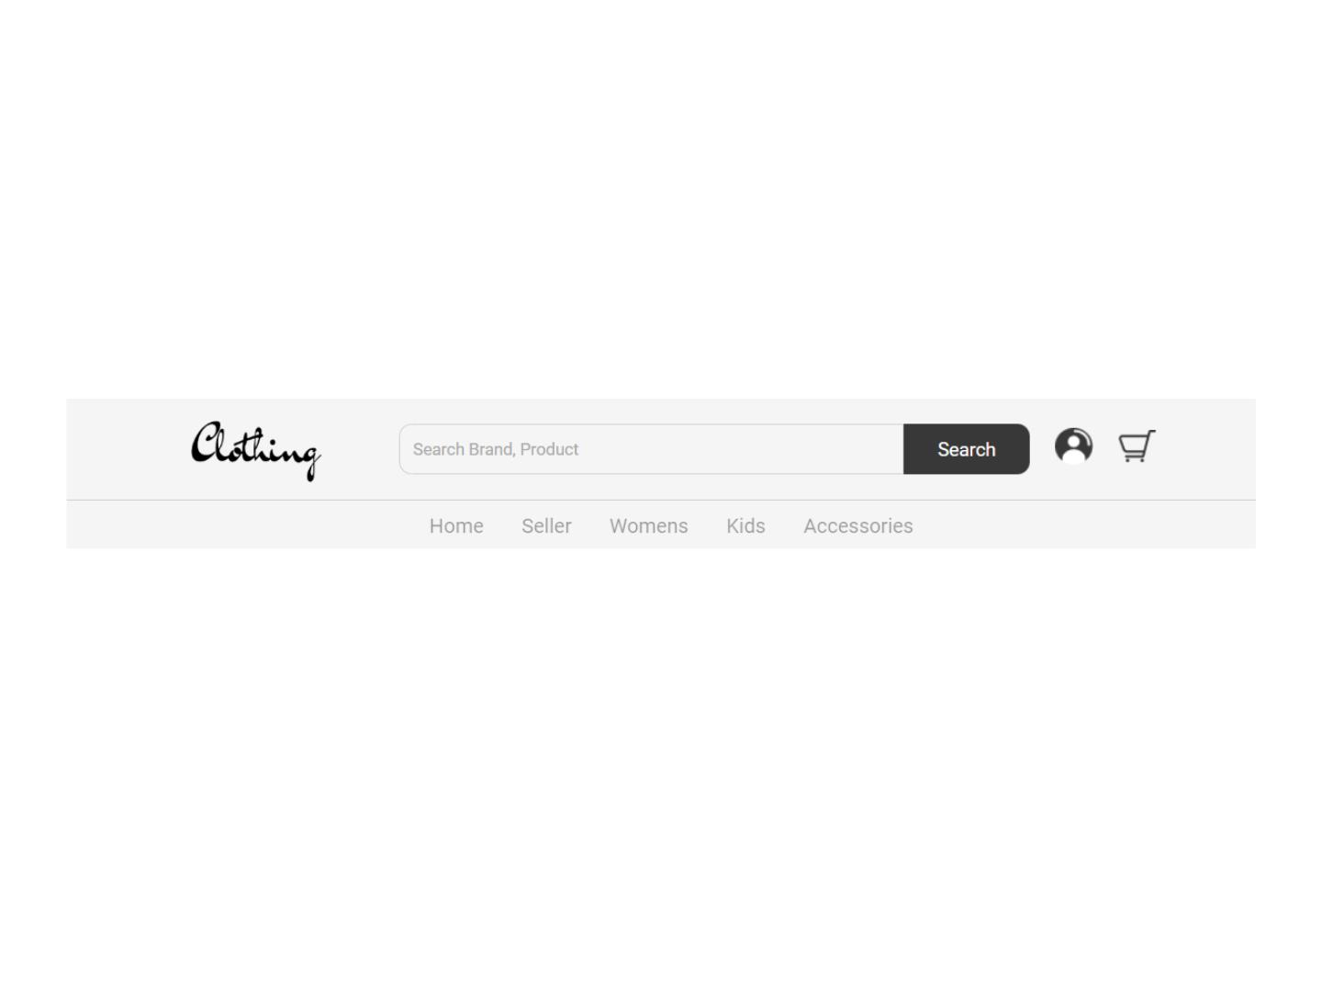
HEADER PAGE

Slide 24
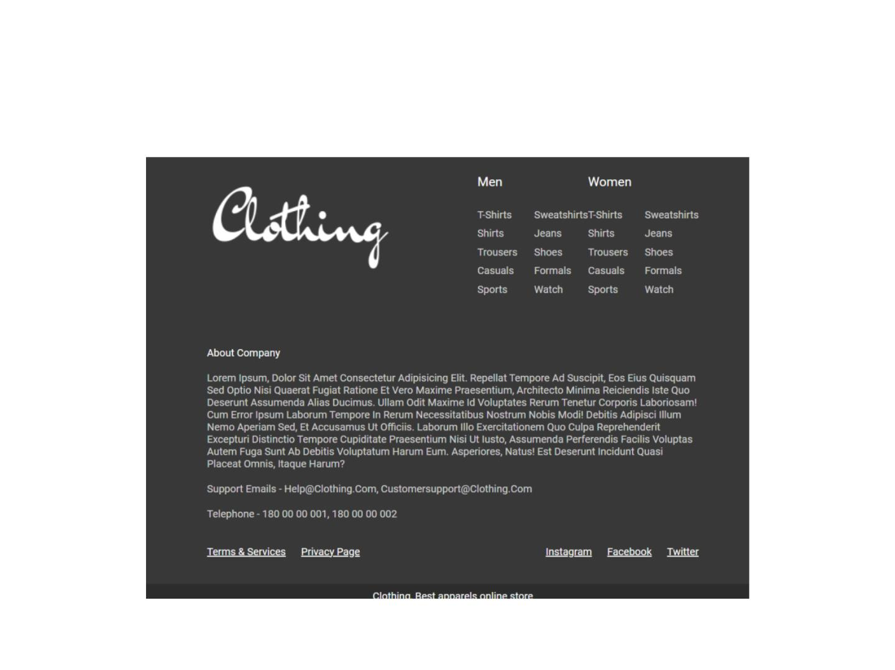
FOOTER PAGE

Slide 25
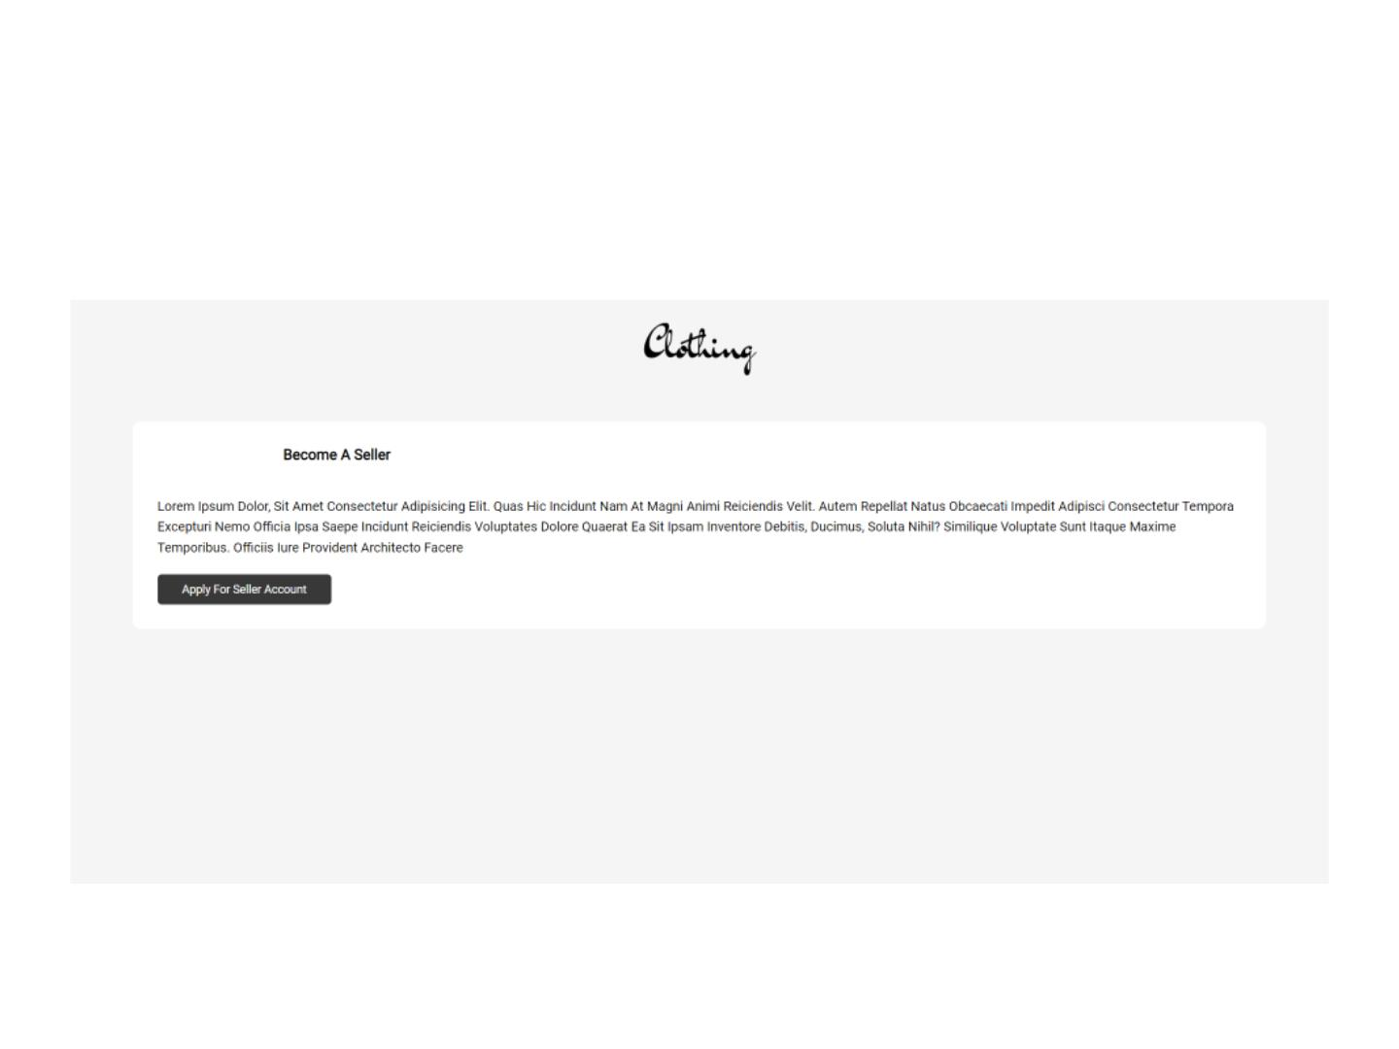
SELLER PAGE

Slide 26
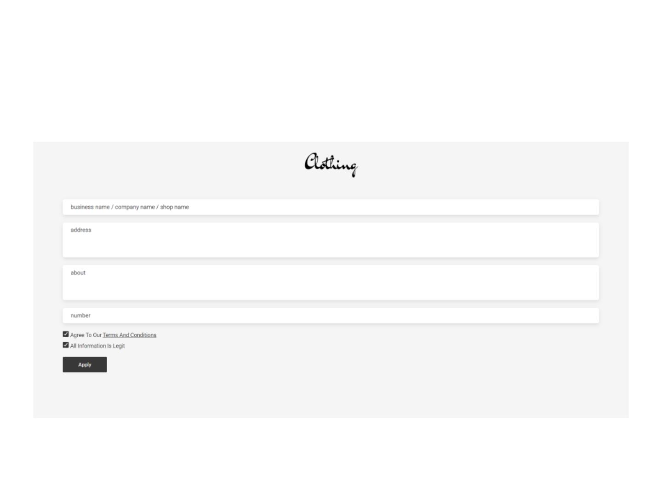
APPLY FOR SELLER

Slide 27
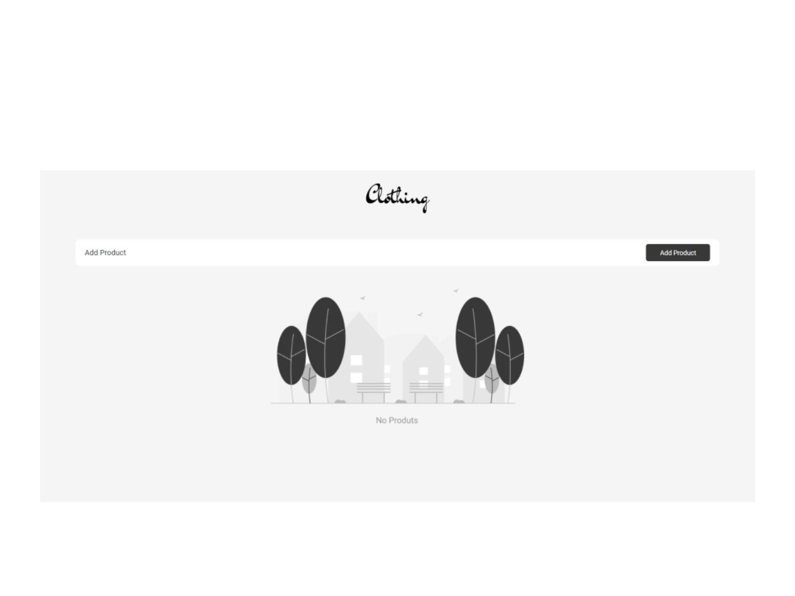
ADDPRODUCT EMPTY PAGE

Slide 28
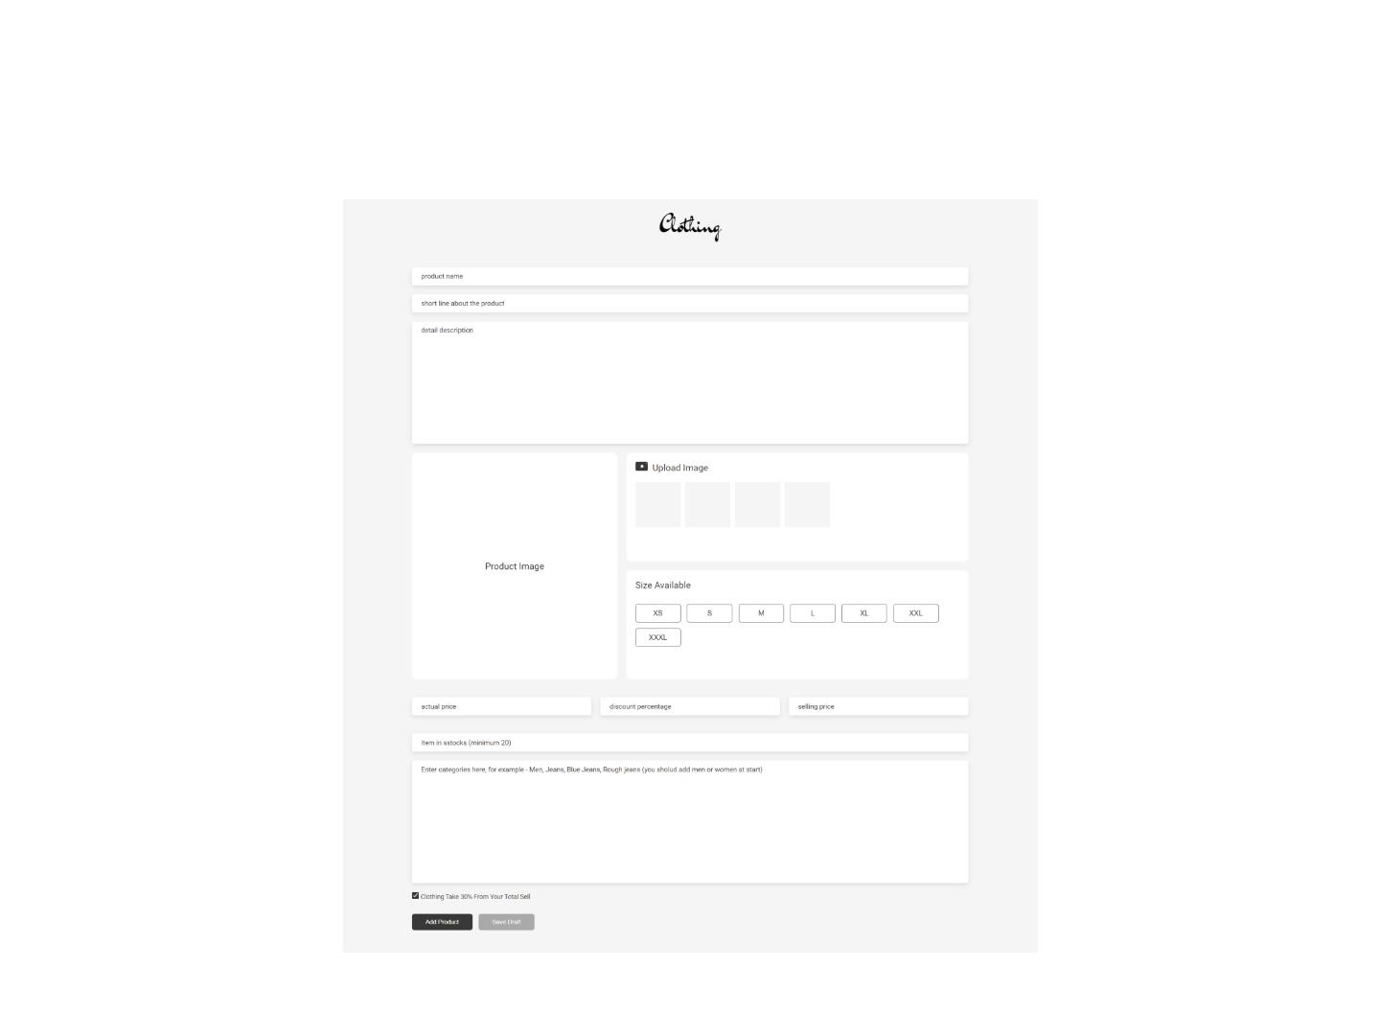
ADDING PRODUCTS

Slide 29
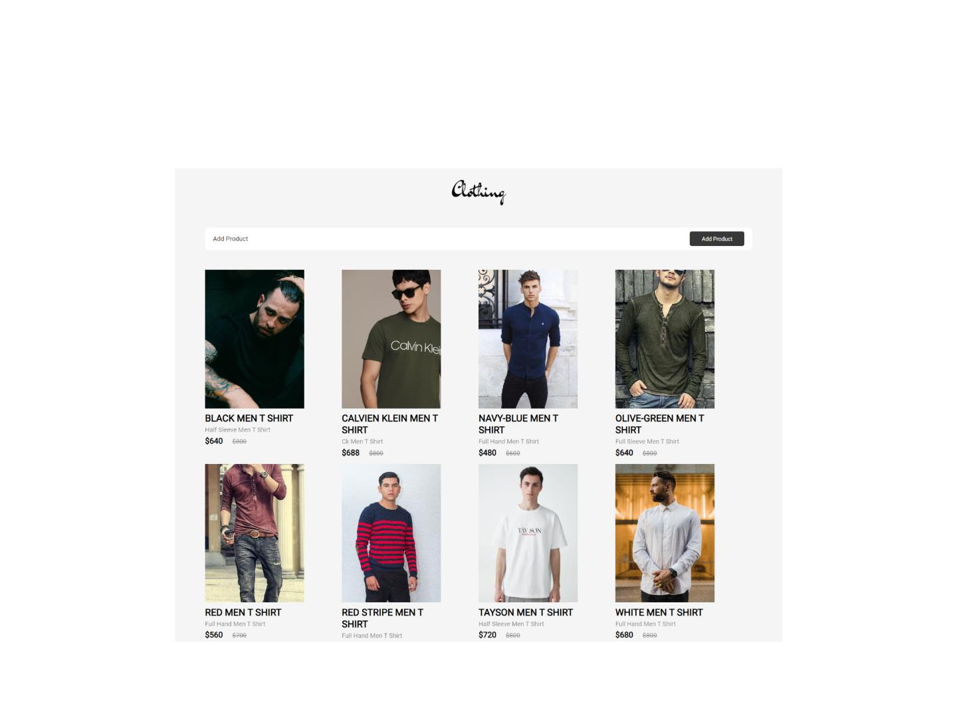
AFTER ADDING PRODUCTS

Slide 30
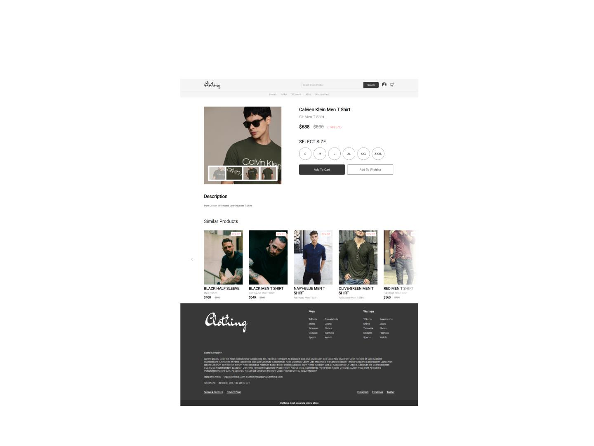
VIEW PRODUCT

Slide 31
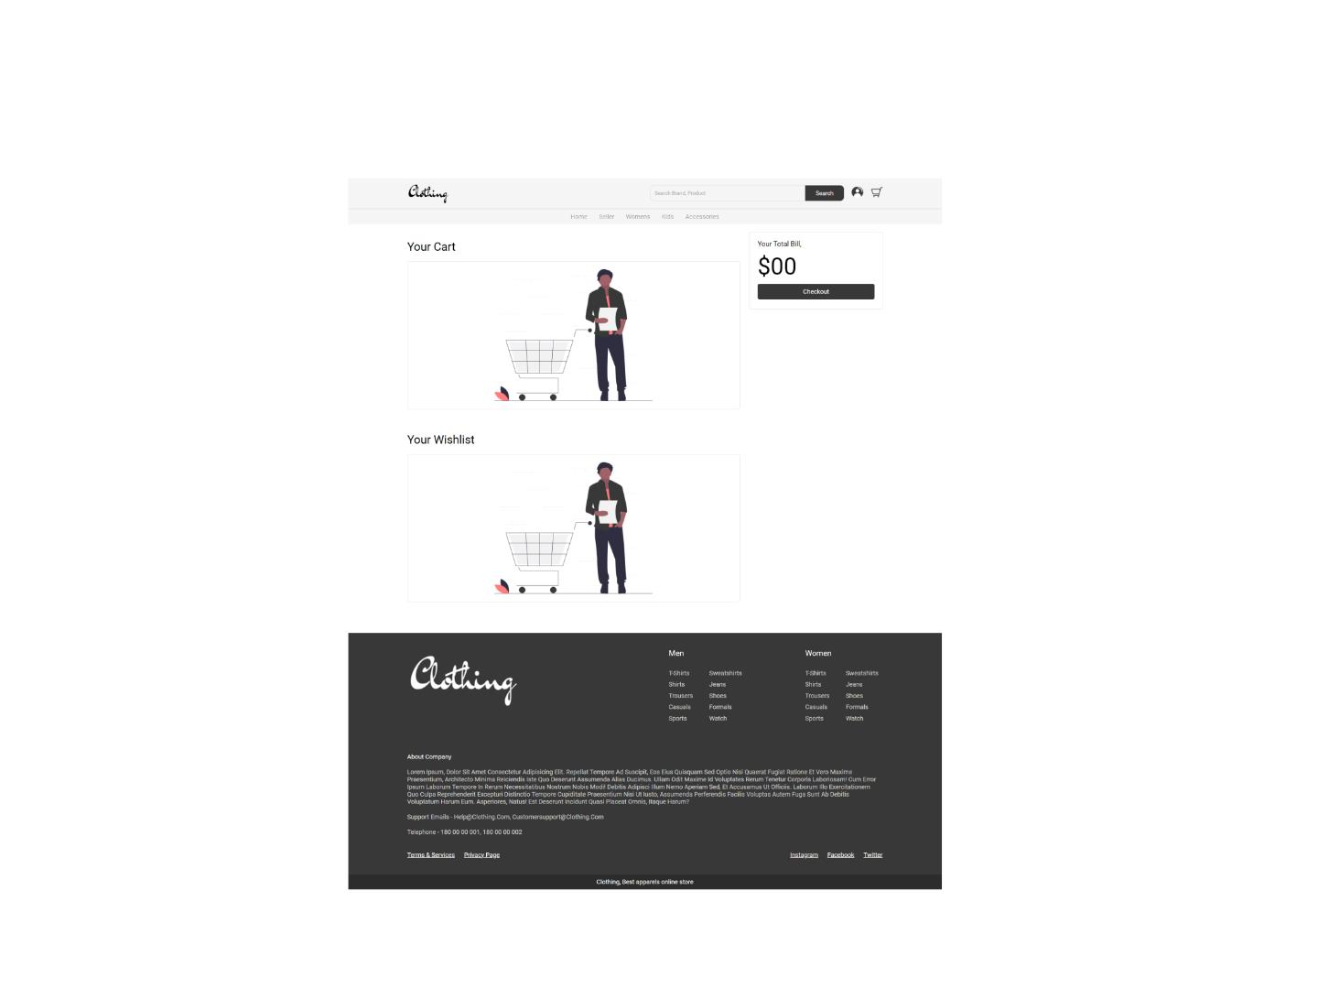
EMPTY CART

Slide 32
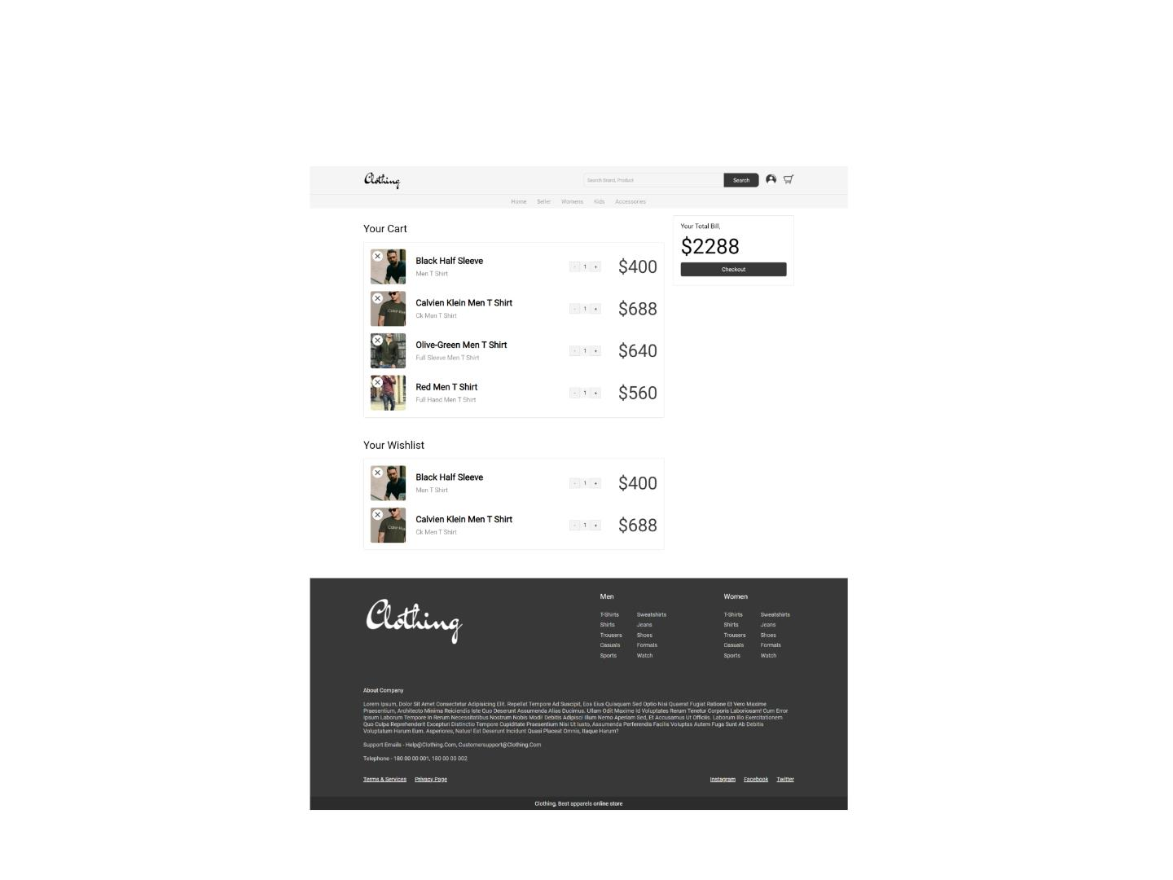
CART PAGE

Slide 33
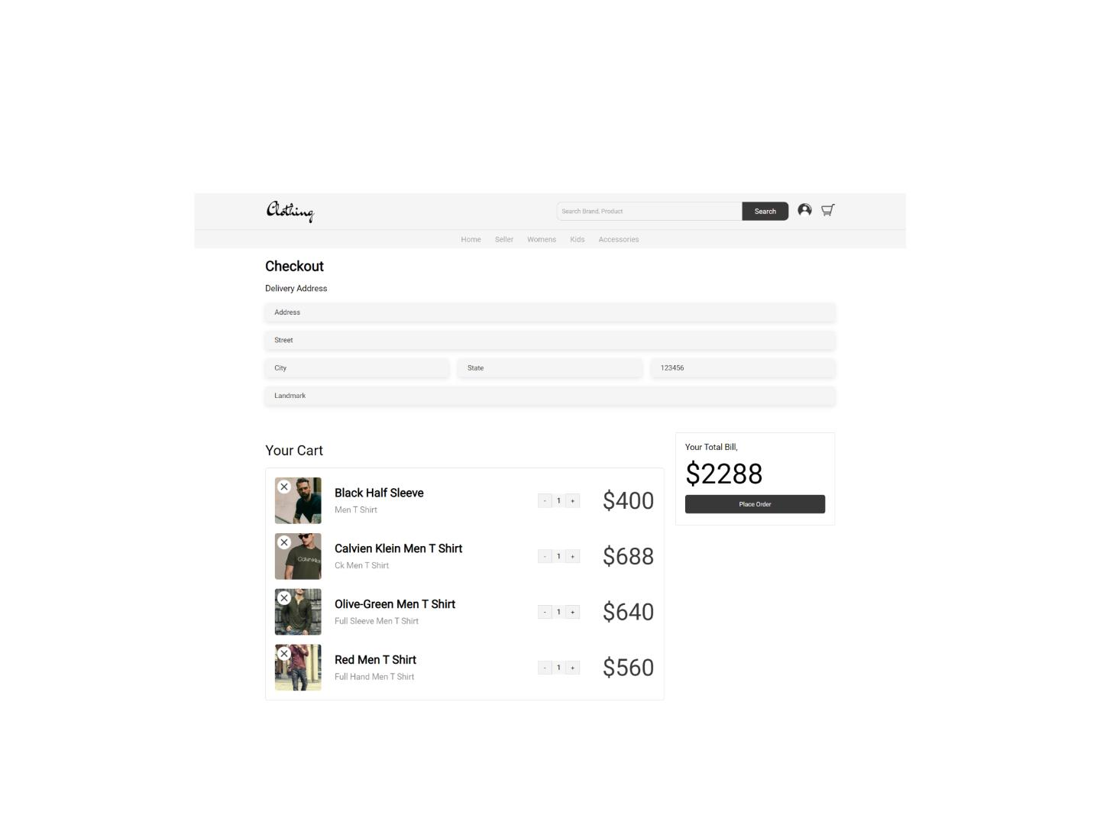
CART-CHECKOUT PAGE

Slide 34
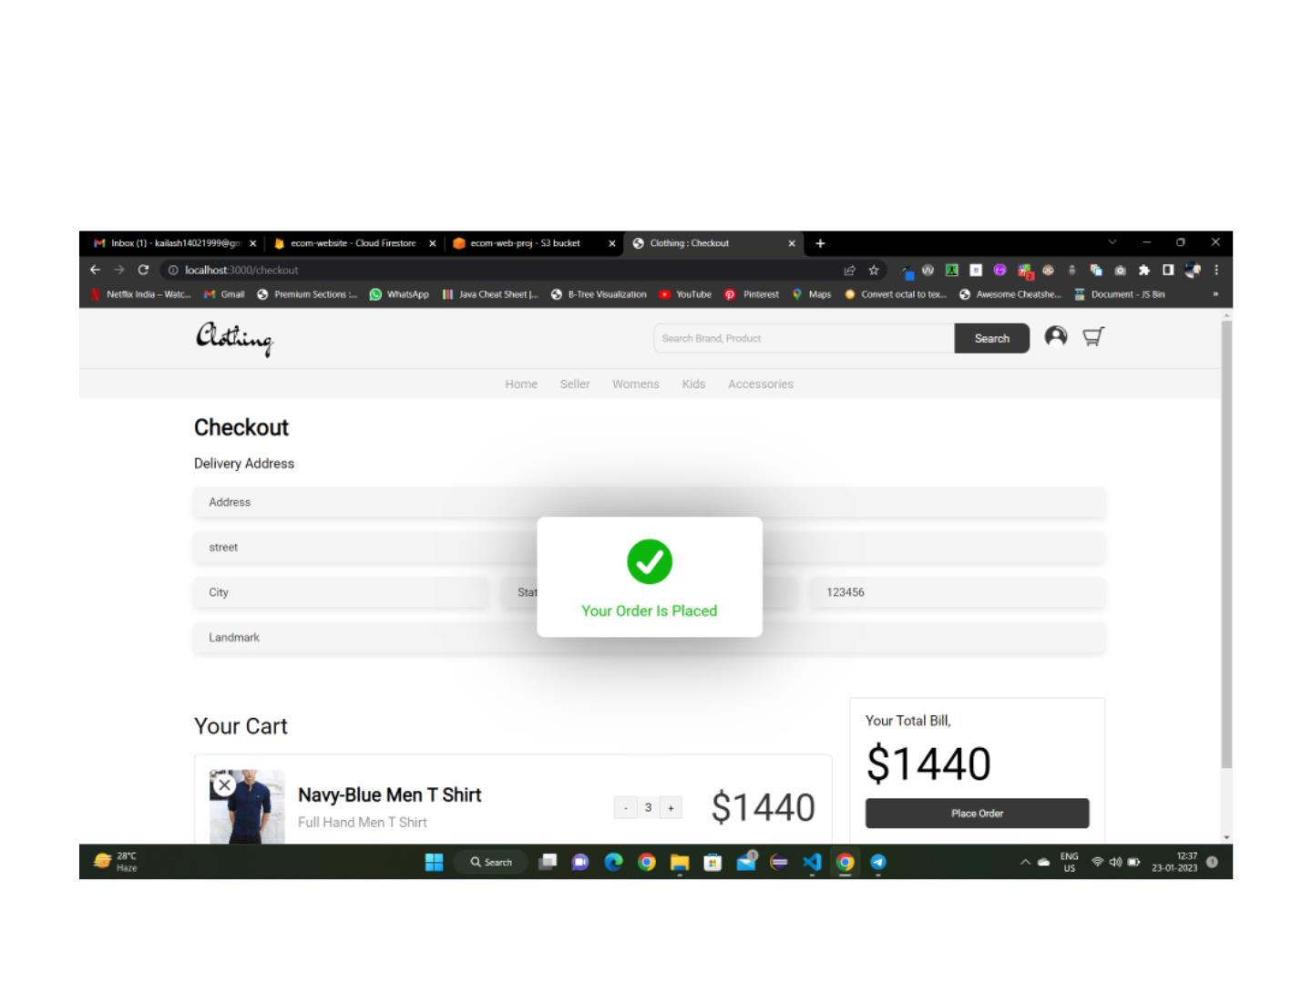
PLACE ORDER

Slide 35
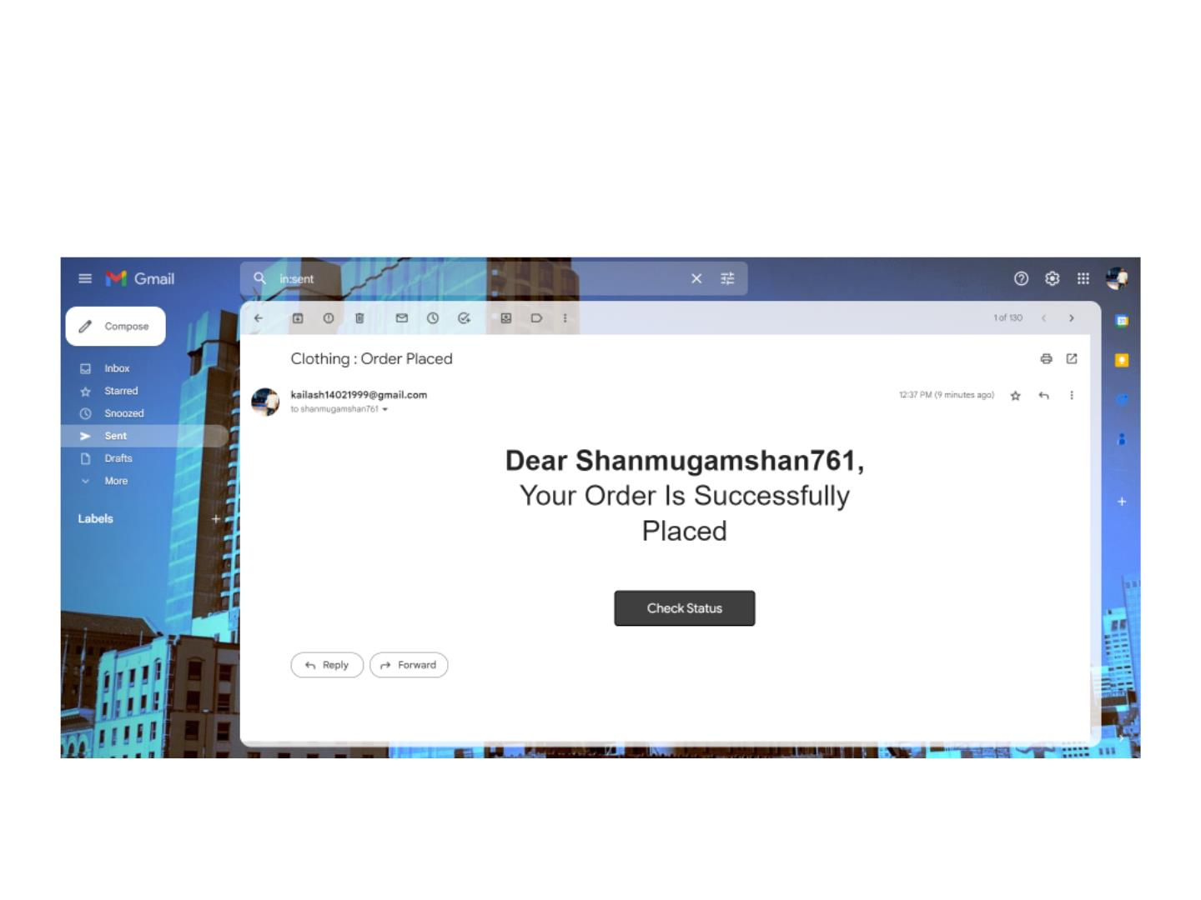
ORDER PLACED SENT MAIL

Slide 36
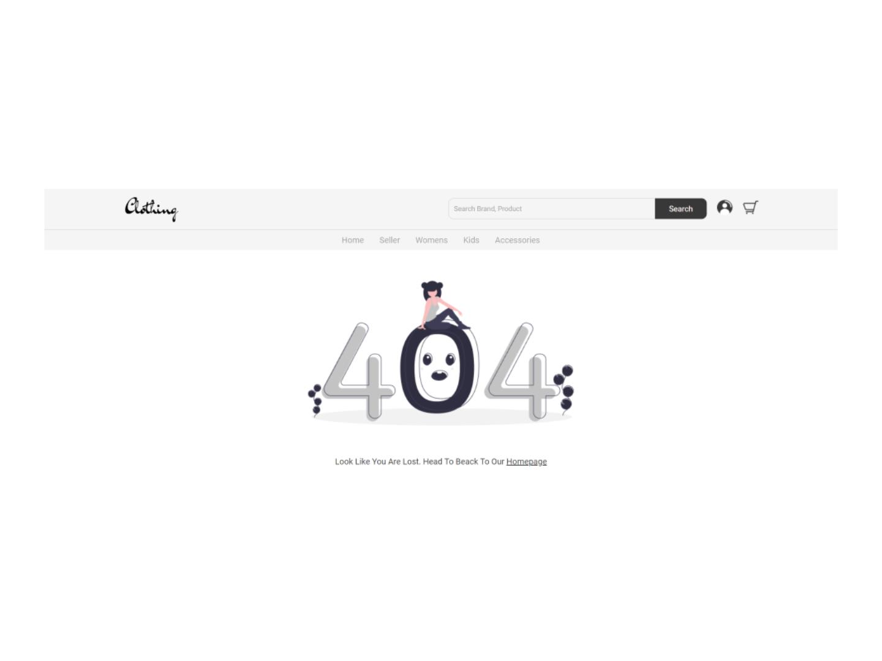
ERROR PAGE

